Slide 1
FAMILY MEDIATION: THE NEED FOR INDIGENOUS KNOWLEDGE AND PRACTICES IN AFRICA
RAZIA NORDIEN-LAGARDIEN; PRETORIUS, B & TERBLANCHE, S
DEPARTMENT OF SOCIAL DEVELOPMENT PROFESSIONS
NELSON MANDELA UNIVERSITY
SOCIAL WORK CONFERENCE 2017
JOHANNESBURG
BIRCHWOOD CONFERENCE CENTRE

Slide 2
INTRODUCTION
Family Law system
Family Mediation
Children’s Act 38 of 2005
Changed status of unmarried fathers
Notes:
Progressive development of Family Mediation in SA
Amendments to legislature - Children’s Act 38 of 2005
Mediation – mandatory
A significant change is that of the status of unmarried fathers.
The Act further states that when there is a dispute between the parents regarding the parental responsibilities and rights of the father, the parties should first seek mediation.

Slide 3
CONTEXTUALIZING THE PROBLEM
Common Law
Indigenous Law
SA Law system
SA: DUAL LEGAL SYSTEM
(Bekker, 2008)
Notes:
Bekker (2008) argues that even though SA has a dual legal system where common law and indigenous law is recognized, the Children’s Act 38 of 2005 has not considered customary law and issues relating to customs and culture

Slide 4
FRAGMENTED FAMILY LAW SYSTEM
(Van Zyl, 1997; De Jong, 2008; Faris, 2011)
Western models
Indigenous models
Notes:
In SA mediation is based on British and American models
The Family Law system in SA is based on Western values and principles
Traditional models are not culture sensitive (Mickel & Boone, ).
Cultural practices influence how individuals engage in dispute resolution (Stalford, 2010:160).
The cultural “baggage” parties bring has decisive impact on the process, approach and outcome of mediation. Culture influences the methods and assumptions underpinning dispute resolution model (Armstrong, 2011).
Westernized approaches to family mediation place limitations on mediation processes

Slide 5
WESTERN
African Indigenous
Building relationships
Peace
Settlement
Agreement
Notes:
Literature indicates that western mediation has as its main objective reaching consensus through settlement; whereas African style mediation focuses on reaching a compromise and healing relationships. It is underpinned by humanistic values and principles of Ubuntu as the restoration of harmony is considered more important than the law (Boniface, 2012). De Jong (2008) proposes a multi-generational model for family mediation which includes the extended family in the process.

Slide 6
What are the issues then?
Inadequate family mediation processes
Mediation outcomes not reached
Challenges in implementation
Best interest of the child not upheld

Slide 7
HOLISTIC APPROACH TO MEDIATION
(Boniface, 2012; De Jong, 2008; SALRC, 2016)
Indigenous knowledge & skills
SA Family Law
Western principles & approaches
Notes:
Holistic approaches to family mediation that recognizes culture in SA have been proposed by various authors ( Boniface, 2012; De Jong, 2008; and SALRC, 2016).
African centred mediation (Mickel & Boone) and mediation with a Traditional Flavor (Ahorsu, 2011) have been proposed

Slide 8
AIM
This paper reports on a specific theme that arose from doctoral study
Doctoral study aim:
To gain a deeper understanding of unmarried parents’ and mediators’ experiences and perceptions of mediation in order to develop guidelines to enhance mediation

Slide 9
.
METHODOLOGY
Qualitative
Phase 1
Design Explorative, descriptive, case study
Sample
Unmarried fathers (7)
Unmarried mothers (7)
Mediators (8)
Phase 2
Integrative review
Guideline development
Data collection
Interviews
Document analysis

Slide 10
UNMARRIED FATHERS | UNMARRIED MOTHERS | MEDIATORS
Theme 1: Perceptions & experiences of mediation | Theme 1: Perceptions & experiences of mediation | Theme 1: Perceptions & experiences of mediation
Theme 2: Challenges impacting on mediation | Theme 2: Challenges impacting on mediation | Theme 2: Challenges impacting on mediation
Theme 3: Suggestions for enhancing mediation | Theme 3: Suggestions for enhancing mediation | Theme 3: Suggestions for enhancing mediation
Theme 4: Factors impacting on co-parenting between unmarried parents | Theme 4: Factors impacting on co-parenting between unmarried parents | Theme 4: Factors impacting on co-parenting between unmarried parents
Theme 5: Perceptions regarding the parental responsibilities and rights of unmarried fathers | Theme 5: Perceptions regarding the parental responsibilities and rights of unmarried fathers | Theme 5: Perceptions regarding the parental responsibilities and rights of unmarried fathers

Slide 11
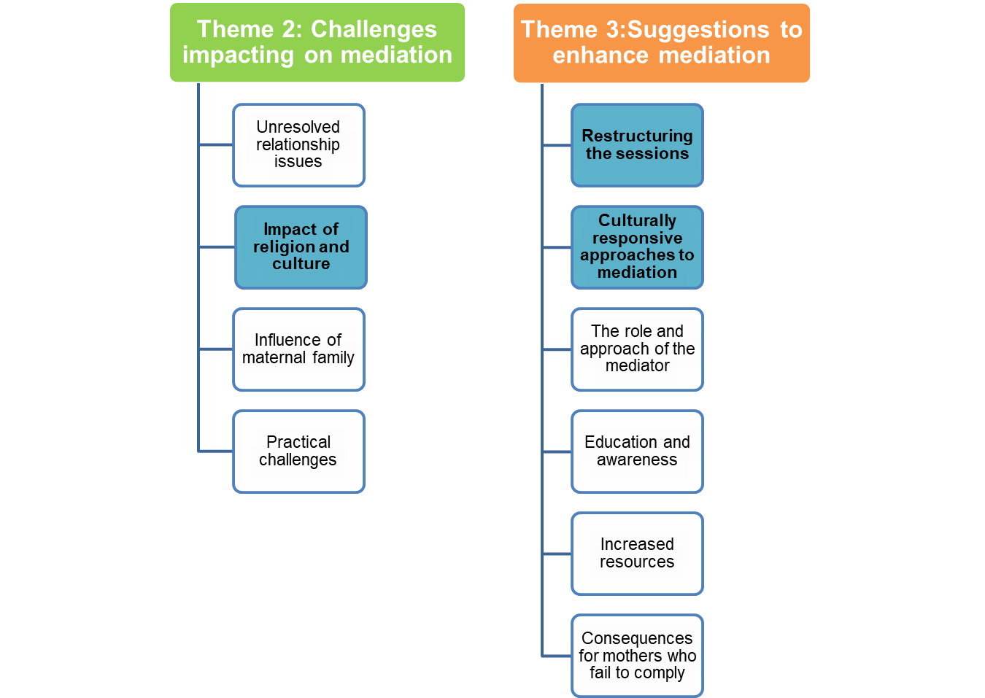
FINDINGS
Engaging the extended family

Slide 12
THEME 2: The impact of culture and religion on mediation
Culture
Law
“Because the lady explained to us that African customs does not apply in this certain aspect of me seeing the child. I not paying damages for the child does not prohibit me from seeing her. I have a right to see my child. That is what was explained to me (SN: L419-423)
Notes:
Culture influenced mediation for fathers and mediators
Culture has a significant influence on the role and rights of Xhosa unmarried fathers.
Tensions between culture and the law in mediation.
Mediations were unsuccessful as a result of cultural issues arising during the mediation

Slide 13
THEME 2: The impact of culture and religion on mediation
Culture
Law
“It was difficult, that is why I’ve stopped mediation, because for me it felt like it doesn’t respect our culture and it is kind of breaking that. Because in our culture, it is important to do things in a certain way. So now the law is kind of discouraging that as if it is not important. And if it is like that, it means even the next generation won’t see that as that important. But for it to be there was a reason for that. And if we are now taking that away, then culturally what is happening?”(FT: L387-395)
Notes:
Culture influenced mediation for fathers and mediators
Culture has a significant influence on the role and rights of Xhosa unmarried fathers.
Tensions between culture and the law in mediation.
Mediations were unsuccessful as a result of cultural issues arising during the mediation

Slide 14
THEME 2: The impact of culture and religion on mediation
Culture
Mediation
“It is also an issue with the father that damages are coming up. And you know that culturally you are supposed to pay damages. “And what are you saying about that”? And for some of them they will say that they will pay damages. Then they will need to follow the process. Although that is not part of the mediation, we do kind of talk about it, so that it will make ease for the women to understand where it is coming from. And also to enable us to do the mediation. Because you find that if he said he is not going to pay damages, then there and then mediation has to stop, because she is not willing”. (FT: L350-361)
Notes:
DAMAGES
TOUCH ON ISUE
MEDIATION STOPS IF NO DAMAGES

Slide 15
THEME 2: The impact of culture and religion on mediation
Culture
Mediation
“Those are one of the challenges. Also customary law, you know… ja cultural interest plays a role in that for instance, in our culture for a black person, that perception that a child that is born out of wedlock belongs to the maternal Family. You know, it is always in interest because you will find that the biological mother is put in a position where she must agree with the Father, who for instance has not paid damages. And she is still staying at her home and it is difficult for her to make a decision, because mommy and daddy at home or they are helping me and looking after the child. Now I must decide I cannot …so sometimes they struggle to reach an agreement in those circumstances”. (LV: L248-260).
Notes:
CUSTOMARY LAW
MATERNAL FAMILY RIGHTS
BIOLOGICAL MOTHER

Slide 16
THEME 2: The impact of culture and religion on mediation
Culture
Mediation
“So often I will work with the grandparents then helping them, to understand what their rights are, and also what the rights of the mother and the father are. And that their perception of what they entitled rights are, is actually not entitled rights. So there is a lot of education within the brown community because I work a lot with them.”(CO: L1059-1065)
Notes:
CUSTOMARY LAW
MATERNAL FAMILY RIGHTS
BIOLOGICAL MOTHER

Slide 17
THEME 2: The impact of culture and religion on mediation
Religion
Mediation
Another significant challenge experienced by all three participant groups in mediation is the religious beliefs of parents which are often in conflict with the law.
When parents have diverse religious beliefs and practices they struggle to compromise and to reach consensus in mediation, often leaving one party feeling unsatisfied with the outcome.
“And they said I can’t teach my daughter anything about my religion, my culture, I can’t teach her my language, and can’t take her out, because I would threaten to take her away, even though I didn’t. And that is why there was a lot of lies there, telling the woman, I think the mediator was also a Christian, so she was giving her a lot of favour”. (HM: L345-351)
Notes:
3 GROUPS
RELIGIOUS BELIEFS IN CONFLICT WITH LAW
DIVERSE BELIEFS = NO CONSENSUS

Slide 18
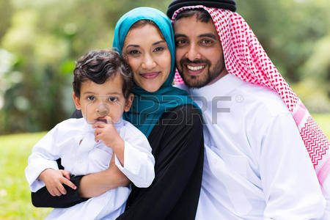
THEME 2: The impact of culture and religion on mediation
“Another challenge is the religious difference. This is challenging especially when it is Muslim/Christian. They only see right and wrong, there is no in between. There is no room for religious differences. There is not much success in these cases because the complexity of cultural and religious differences are too challenging.”(JE: L131-136)

Slide 19
THEME 3: Suggestions to enhance mediation
Culturally responsive approaches to mediation
Restructuring sessions in mediation
Engaging the extended family in mediation
Notes:
Three sub-themes

Slide 20
Sub-theme : Culturally responsive approaches to mediation
Culture
Mediation
The participants in the study suggested the use of more culturally relevant approaches to mediation to manage cultural challenges.
“I wonder if maybe mediation in some situations, needed to take a different form that was more culturally relevant. (JP: L314-316).
“I think to be aware of the culture that you have to work with. It might be something with English speaking people, that they might not know, with the Xhosa background in terms of culture, so if we are talking about damages, what it entails and all that. Just that you know.”(FT: L911-916)
Notes:
This was a suggestion made by mediators to enhance mediation processes and outcomes for families.

Slide 21
Sub-theme: Restructuring sessions in mediation
One session insufficient
Pre-mediation session in order to prepare parties for mediation where the process and purpose of mediation would be explained to them.
Assess potential challenges which may influence the process at a later stage such as culture or religion
“Between unmarried parents, do not just invite the applicant and the respondent to mediation. Setup an appointment with the applicant. Obviously you are going to hear from your applicant first, depending on how the intake is done, so you speak to either of the parties first. Applicant separate from Respondent. Get the picture of where the person is at, what is the perception of the problem, and then prepare, prepare the two parties to join”. (SD: L1263-1272)
Notes:
One session insufficient
Pre-mediation
Assessment of challenges

Slide 22
Sub-theme: Engaging the extended family in mediation
In certain cultures and communities when a child is born out of wedlock that child belongs to the grandparents and not the mother as she is unmarried.
Grandparents and extended family thus have certain rights over the child in terms of their culture
This is an important aspect to acknowledge and take into consideration in mediation as it impacts on the process of mediation
“But even when we talked to Grandmother, she eventually understands where we were coming from. My conversation with them were, don’t get involved now, I would not say that, I would just explain to them why they must give chance to mother and father to parent the child. And how important their support is to them”. (ZB: L1126-1132).
“So sometimes I have to go back, sometimes you need to end the mediation and I need to go back and educate mother, granny, uncle, and then they get it, things is then getting so much better”. (SD: L385-3880
“We allow the grandparents to vent, but in the end we explain to them that in terms of the law we enforce the co-parents”. (LV: L273-275)
Notes:
Maternal family rights over child born out of wedlock
Impacts on mediation
Want to be part of mediation

Slide 23
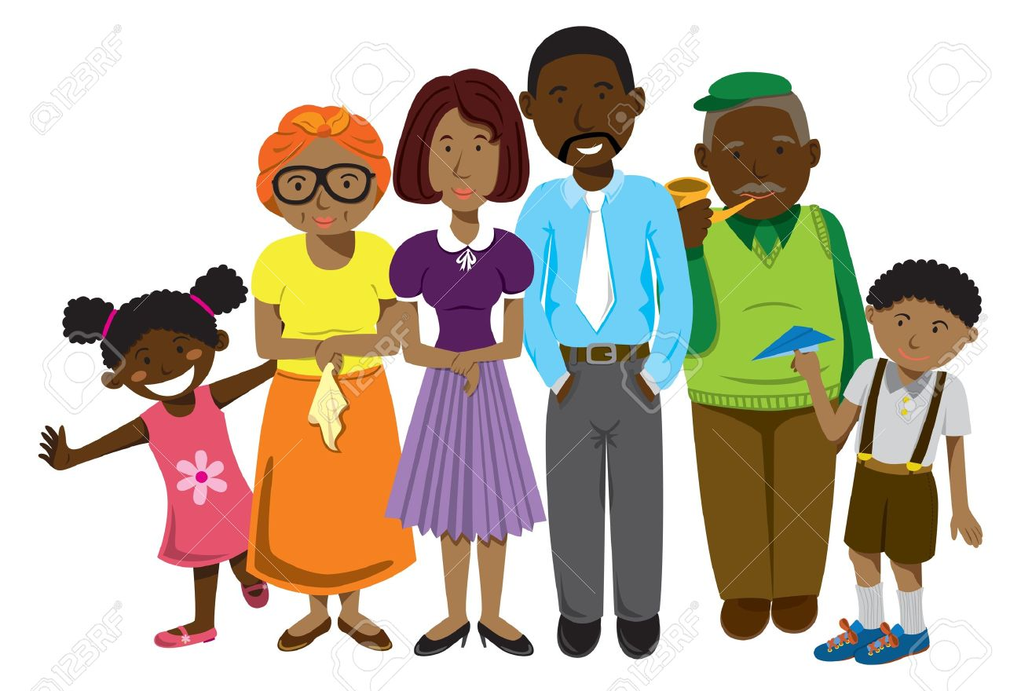
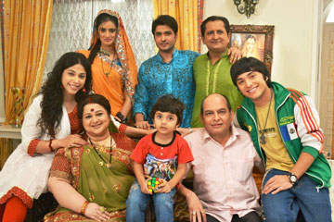
Sub-theme: Engaging the extended family in mediation
It is important to note from these quotes above that mediators merely engaged the extended family to explain the process of mediation and the parental rights of the father.
What is lacking is culturally competent approaches to acknowledging and including the family in mediation as would be expected in their culture.
The suggestion earlier by various authors regarding multigenerational mediation is thus highlighted in this study as an important component of culturally relevant approaches to mediation.
Notes:
Merely engage
No inclusion
Multi-generational mediation-link

Slide 24
SUMMARY & CONCLUSIONS
Challenges that culture and religion can pose on mediation which has also been identified in the literature earlier.
Rights of Xhosa unmarried fathers vs Rights of maternal grandparents
Diverse religious beliefs of parents
The need for more culturally relevant approaches to mediation in order to enhance the process of mediation.
Family Law system as it pertains to family mediation in South Africa needs to be developed and be inclusive of indigenous knowledge and approaches to accommodate the diversity of families across the cultural domain of South Africa.

Slide 25
WHAT IS THE WAY FORWARD?
Critical Reflection
What is the role of social work in promoting a culturally responsive approach to family mediation?
Why, in spite of efforts to develop mediation in SA and the Children’s Act, has not much been achieved form a social work perspective to make the practice of mediation more culturally relevant?
How do we take the lead in developing Indigenous approaches to Family Mediation in SA?
If we don’t set the agenda , others will set it for us.

Slide 26
RECOMMENDATIONS
Ways of re-thinking mediation processes
What is more applicable to SA context, given the diversity and history of families in SA?
Which practices will render culturally relevant mediation to families in SA?
What will enable mediators to work in more complex and changing terrains?
Curriculum should create opportunities for more balanced knowledge, skills and processes
How do we honour indigenous belief systems?

Slide 27
RECOMMENDATIONS
Principles of self-determination and social justice –upheld through indigenous practices
Indigenous knowledge systems should be explored and integrated with relevant approaches in current western models to enhance efficiency and effectiveness in mediation.
An appropriate model for mediation should be developed for social work practice which allows mediators flexibility to adapt to various cultures while remaining true to the principles underpinning mediation.
It is further recommended that practitioners be invited and encouraged to have dialogues and discuss the practice of traditional customs in order to address the ways in which they impact on parent-child relationships and to explore solutions to address these challenges while adhering to the principles of the best interest of the child.

Slide 28
REFERENCES
Ahorsu, K. and Ame, R. 2011. Mediation with a traditional flavor in the Fodome Chieftaincy and communal conflicts. African Conflict and Peacebuilding Review, Issue 1, vol 2., pg6-33.
Armstrong, S.M. 2011. Encouraging conversations about culture: Supporting culturally responsive family dispute resolution. Journal of Family Studies, vol. 17. Issue 3, pg 233- 248.
Bekker,. J.C. 2008. Commentary on the impact of the Children’s Act on selected aspects of the custody and care of African children in South Africa. Orbiter, vol 29, issue 3. pg 395-405
Boniface, A. E. 2012. African- style mediation and western-style divorce and family mediation: Reflections for the South African Context. PER, vol 15, no.5. pg 378-401
Children’s Act 38 of 2005. Government Gazette, 19 June 2006, 492(28944).
De Jong, M. 2005. An acceptable, applicable and accessible family-law system for South Africa- some suggestions concerning a family court and family mediation.
De Jong, M. 2008. Opportunities for Mediation in the New Children’s Act 38 of 2005. THRHR.
Eddy, M.M.; Thomson-de Boor, H.; & Mphaka, K. 2013. “So we are ATM fathers”:A study of absent fathers in Johannesburg. University of Johannesburg, Sonke Gender Justice Network & CSDA.
Family Dispute Resolution: Care of and contact with children. 2016. South African Law Reform Commission (SALRC). Project 100D.
Faris, J.A.. 2011. From Alternative Dispute Resolution to African Dispute Resolution: Towards a new vision. Paper presented at 5th Crribean Conference on Dipsute Resolution.
Makusha, T. and Richter, L. 2016. Gatekeeping and its impact on father involvement among Black South Africans in rural Kwazulu- Natal. Culture, Health & Sexuality, vol. 18, no.3, pg 308-320.
Mickel, E. & Boone, C. 2001. African Centred Family Mediation: Building on family strengths. International Journal of Reality Therapy. Vol. xxi, no1, (pg 38-41)
Stalford, H. 2010. Crossing boundaries; reconciling law, culture and values in international family mediation. Journal of Social Welfare and Family Law, vol. 32. no.2, pg 155-168.
Van Zyl, L. 1997. Divorce mediation and the best interests of the child. Pretoria. HSRC.
Velthuizen, A. Nov 30 2014 Sunday Independent

Slide 29
THANK YOU

